Slide 1
Selecting a Location for a New Business
Coursera Capstone

Slide 2
Introduction
It is important for the client to select an optimal location for opening up their businesses.
Location is very important because it can determine whether a newly open business can survive or not.
In this study, we will look into opening a coffee shop in the City of New York and select an optimal area.

Slide 3
Data Obtained
ZIP Codes and Neighborhoods scraped from health.ny.gov
Location of neighborhoods/ ZIP Codes obtained from Google Geocode API
General latitude and longitude of the ZIP Code
Suggested boundary locations given by Northeast and Southwest Lat Lng were used to assemble boundaries in a makeshift GeoJSON
Locations of coffee shops obtained from Foursquare API
Duplicate stores were dropped.

Slide 4
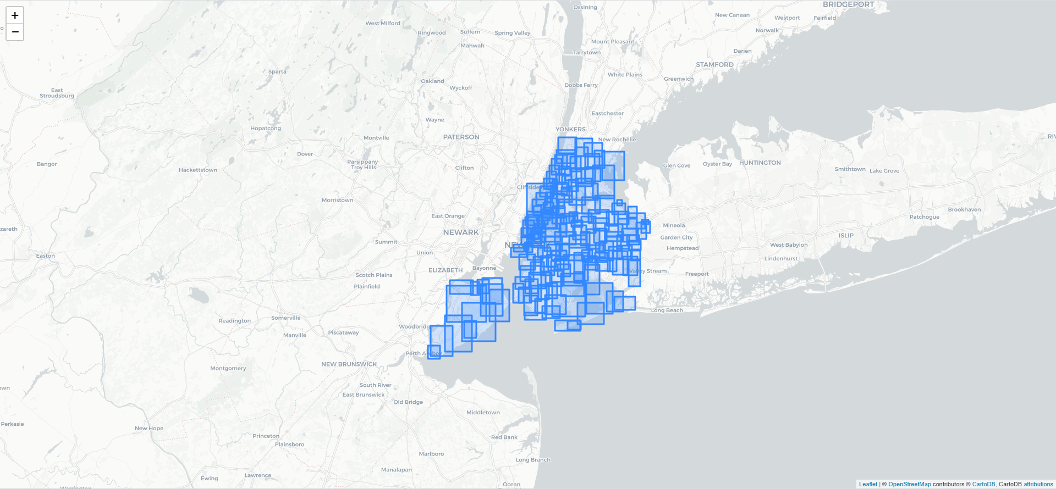
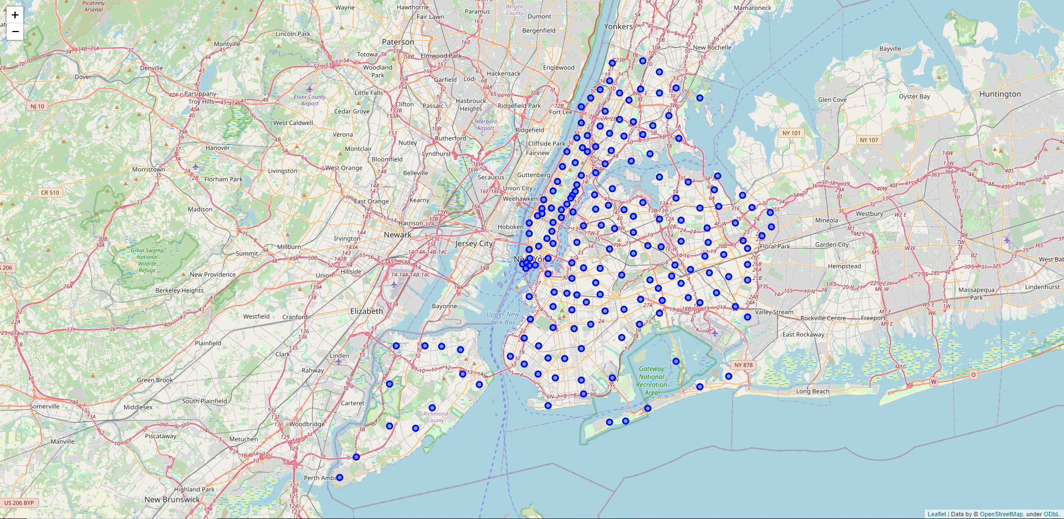
Visualizing the New York City Area
The ZIP Code were plotted (bottom picture) and its boundary (top picture) was plotted after assembling coordinates obtained from Google Geocoding API.

Slide 5
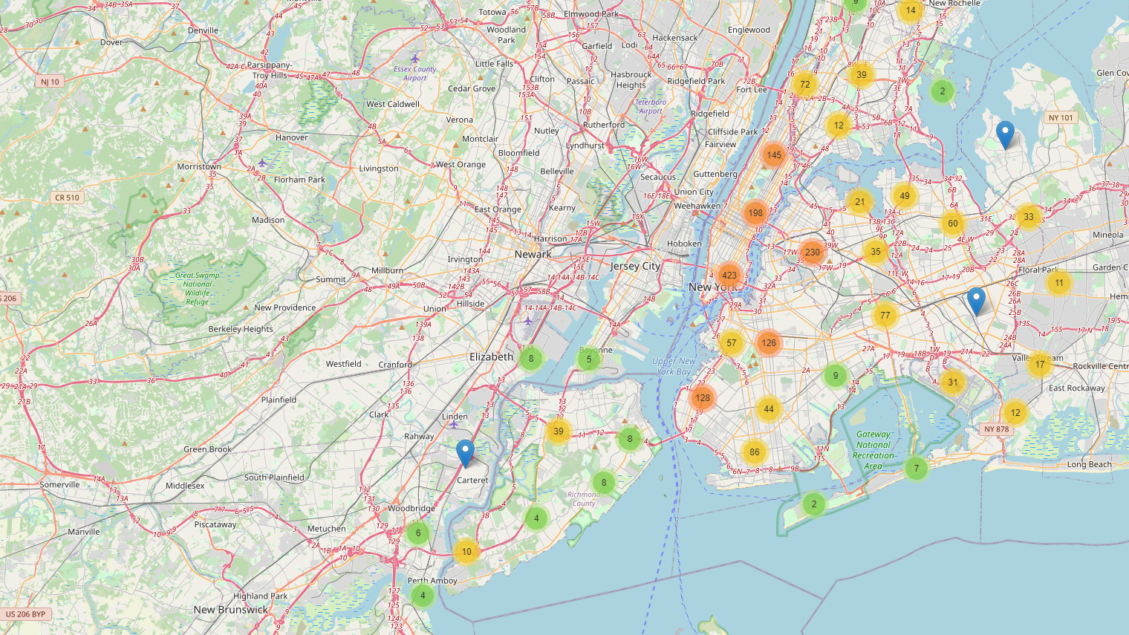
Visualizing Similar Businesses
After obtaining the locations from Foursquare API, the business’s location was plotted on a Folium Map to get a general idea of where everything is.

Slide 6
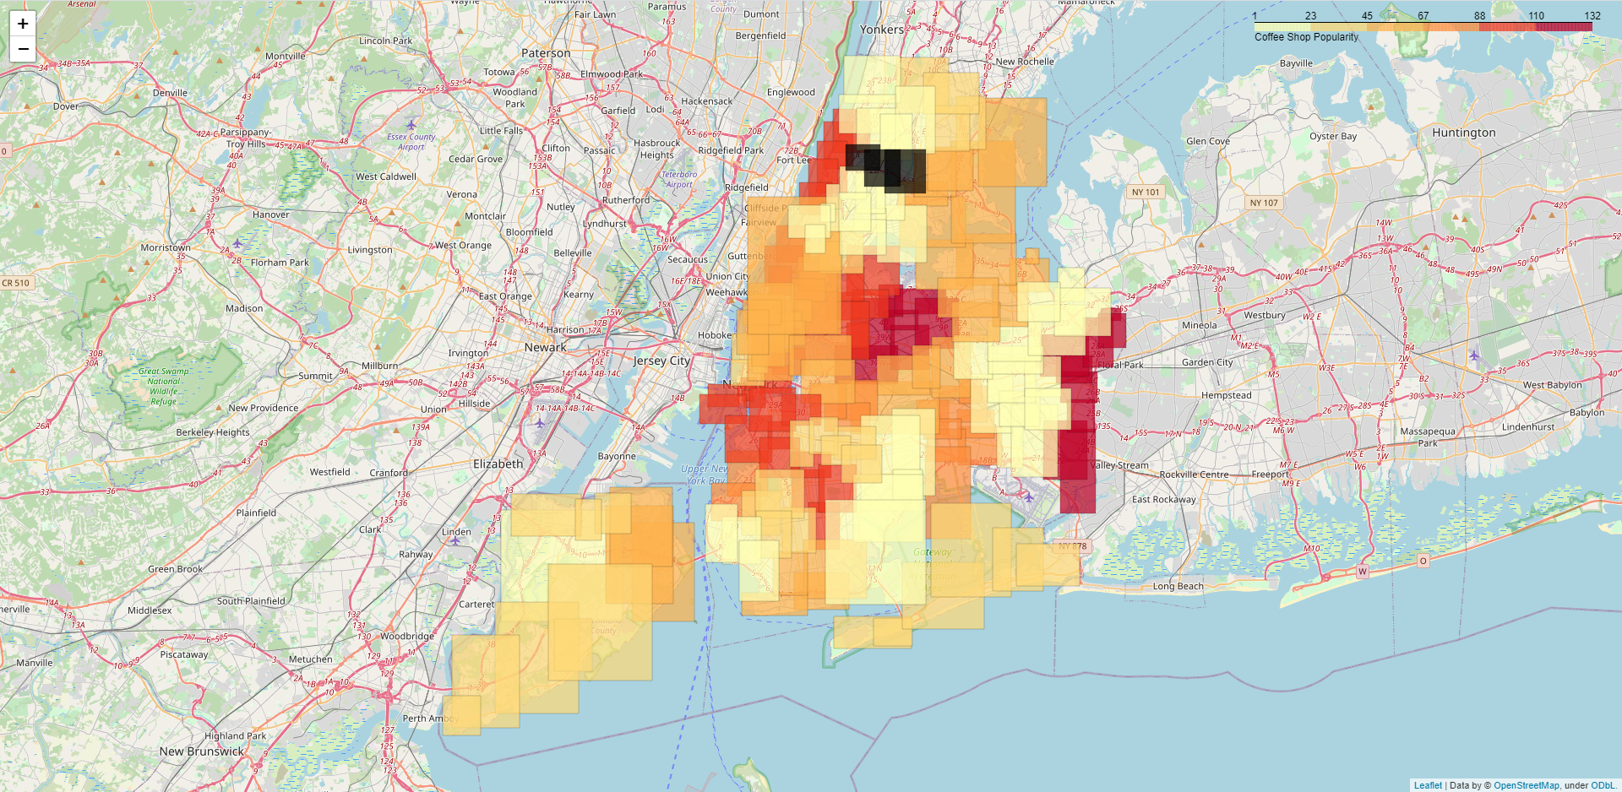
Visualizing Similar Businesses
Coffee shop locations were combined with Neighborhoods and plotted using a Chloropleth Heatmap to see areas with hot spots and cold spots for coffee shops.

Slide 7
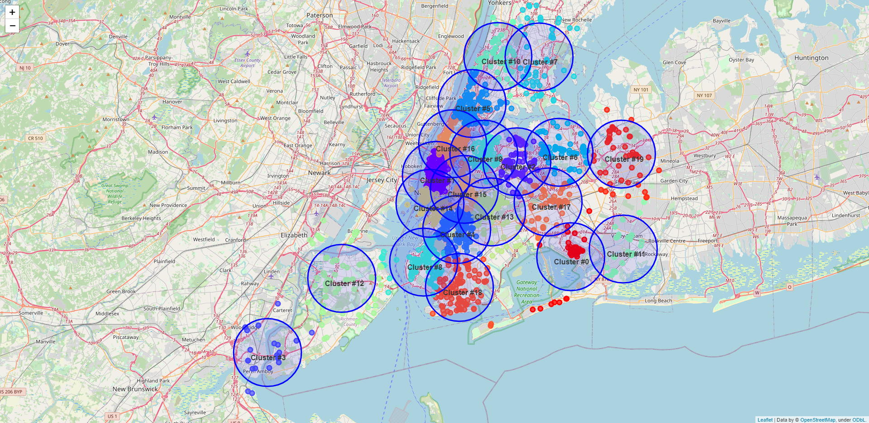
K-Means
K-Means was used to create clusters of coffee shops and plotted onto a Folium Map to visualize

Slide 8
Results
Neighborhood | Total
West Queens | 132
Southeast Queens | 131
Northwest Brooklyn | 107
Upper West Side | 104
Lower Manhattan | 103
Lower East Side | 103
Flatbush | 98
Inwood and Washington Heights | 90
Northwest Queens | 90
Bushwick and Williamsburg | 81
Sunset Park | 79
Southwest Queens | 71
Upper East Side | 68
North Queens | 66
Gramercy Park and Murray Hill | 61
Chelsea and Clinton | 53
Southern Brooklyn | 53
Greenpoint | 53
Stapleton and St. George | 50
Southeast Bronx | 49
West Central Queens | 46
Greenwich Village and Soho | 44
Northeast Bronx | 41
Borough Park | 39
East Harlem | 39
Rockaways | 36
South Shore | 35
Central Brooklyn | 26
Port Richmond | 26
Southwest Brooklyn | 16
Central Harlem | 12
Hunts Point and Mott Haven | 10
Mid-Island | 8
Kingsbridge and Riverdale | 8
Canarsie and Flatlands | 7
Jamaica | 3
Bronx Park and Fordham | 3
Central Queens | 2
East New York and New Lots | 1
Northeast Queens | 1
High Bridge and Morrisania | 1
cluster_label | Total
1 | 217
16 | 202
4 | 166
5 | 159
14 | 141
8 | 140
9 | 134
18 | 114
13 | 103
15 | 97
6 | 89
2 | 86
12 | 71
10 | 64
17 | 58
7 | 56
19 | 53
0 | 43
11 | 31
3 | 22
There is a higher count of coffee shops in West Queens (132) and Southeast Queens (131)
There is a lower count of coffee shops in High Bridge and Morrisania (1), East New York and New Lots (1), and Northeast Queens (1)
There is a higher concentration of coffee shops in cluster #1 (217)
There is a lower concentration of coffee shops in cluster #3 (22)

Slide 9
Recommendation
Most competition
(based on cluster #9 and statistical count)
Most competition
(based on cluster #1)
Least competition
(based on cluster #0)

Slide 10
Conclusion
The model predicted used only the locations of similar businesses and the neighborhoods/ZIP Codes of New York City.
Further improvement to the selection of the location/area to open up the business can incorporate:
Survey data of likelihood someone would patron “X” business
Use crime rate statistics of the neighborhoods to influence on the recommendation of opening “X” business
Median income of the area to understand if the business type fits in this area

